Slide 1


Green Pace
Security Policy Presentation
Developer: Douglas Rowland
Notes:
Hello everyone, my name is Douglas Rowland, and today I will be presenting the Green Pace Security Policy. This presentation will cover the importance of secure coding, the threats we face, and the policies and tools we use to protect our systems

Slide 2

OVERVIEW: DEFENSE IN DEPTH
The Green Pace Security Policy standardizes secure coding practices to reduce risks and ensure compliance. By integrating security into the DevSecOps pipeline, we strengthen system resilience through automated enforcement and layered protection.
Notes:
The Green Pace Security Policy standardizes secure coding practices to mitigate risks and ensure compliance. By integrating security into our DevSecOps pipeline, we create a secure, multi-layered defense that enforces security policies through automation and systematic protection.

Slide 3
THREATS MATRIX
SQL Injection: Attackers may inject malicious queries, compromising data integrity Buffer Overflows: Can be exploited for remote code execution | Memory Corruption: Can lead to crashes, privilege escalation, or data leaks Insecure Authentication: Weak authentication can expose sensitive data
Hardcoded Credentials: A risk but less likely if proper secret management is enforced Deprecated Functions: Legacy code may introduce vulnerabilities but has limited impact if updated. | Race Conditions: Rare but can lead to unpredictable behavior and security flaws Side-Channel Attacks: Less common but still a concern for cryptographic operations
Notes:
This matrix categorizes potential threats based on likelihood and priority. High-priority threats include SQL injection and memory corruption, which can cause significant damage. Medium-priority risks involve input validation and random number generation. Lower-priority risks, such as assertions and error handling, still enhance security but are not immediate threats

Slide 4
10 PRINCIPLES
Validate Input Data: Prevents injection attacks and ensures data integrity. (STD-001-CPP, STD-002-CPP)
Heed Compiler Warnings – Helps catch potential issues early. (STD-005-CPP, STD-006-CPP)
Architect and Design for Security – Security should be built into the system from the start. (All standards)
Keep It Simple – Complexity introduces security risks. (STD-003-CPP, STD-008-CPP)
Default Deny – Restrict access by default. (STD-004-CPP, STD-009-CPP)
Principle of Least Privilege – Limit access to only what is necessary. (STD-010-CPP)
Sanitize Data Sent to Other Systems – Prevents injection and formatting issues. (STD-003-CPP, STD-004-CPP)
Practice Defense in Depth – Multiple layers of security reduce risk. (All standards)
Use Effective Quality Assurance – Testing and code reviews catch vulnerabilities early. (STD-006-CPP, STD-007-CPP)
Adopt Secure Coding Standards – Follow industry best practices to minimize risks. (All standards)
Notes:
We adhere to 10 key security principles, such as validating input data to prevent injection attacks, keeping systems simple to minimize vulnerabilities, enforcing the principle of least privilege, and adopting secure coding standards. Each principle aligns with industry best practices to fortify our software development lifecycle

Slide 5
CODING STANDARDS
Validate Input Length (STD-001-CPP) – Prevents buffer overflows and memory corruption.
Validate Data Values (STD-002-CPP) – Ensures proper input validation to prevent crashes or logic errors.
Ensure String Correctness (STD-003-CPP) – Protects against buffer overflows and injection attacks.
Prevent SQL Injection (STD-004-CPP) – Uses parameterized queries to prevent database compromise.
Ensure Memory Protection (STD-005-CPP) – Avoids memory leaks, dangling pointers, and buffer overruns.
Use Assertions to Verify Assumptions (STD-006-CPP) – Helps catch logic errors early.
Use Exceptions for Error Handling (STD-007-CPP) – Provides structured error handling.
Avoid Dangerous Functions (STD-008-CPP) – Replaces unsafe C functions like ‘gets()’ and ‘strcpy()’
Use Secure Random Number Generation (STD-009-CPP) – Prevents predictable security flaws.
Avoid Hardcoded Sensitive Data (STD-010-CPP) – Ensures credentials and keys are stored securely.
Prioritization:
High Priority: SQL Injection, Memory Protection, and Hardcoded Credentials are critical because they can lead to severe data breaches.
Medium Priority: Input Validation, String Correctness, and Secure Random Number Generation are essential but less immediate threats.
Lower Priority: Assertions and Error Handling improve security but are not direct security threats.
Notes:
Our coding standards enforce best practices to prevent vulnerabilities. For example, validating input length avoids buffer overflows, using parameterized queries prevents SQL injection, and banning unsafe functions like strcpy() enhances memory safety. These standards are prioritized based on their impact, with high-priority rules addressing the most critical security concerns.

Slide 6
ENCRYPTION POLICIES
Encryption in Flight: Protects data as it moves over networks using TLS (Transport Layer Security) to prevent interception.
Encryption at Rest: Ensures stored data is protected using AES-256 encryption to prevent unauthorized access.
Encryption in Use: Secures data while being processed using memory encryption techniques like Intel SGX or homomorphic encryption.
Notes:
Data security is critical at every stage. Encryption in flight protects data during transmission using TLS, encryption at rest secures stored data using AES-256, and encryption in use safeguards active data through advanced memory encryption techniques like Intel SGX

Slide 7
TRIPLE-A POLICIES
Authentication: Requires multi-factor authentication (MFA) to verify user identity before granting access.
Authorization: Implements role-based access control (RBAC) to limit permissions based on user roles.
Accounting: Logs user activity, including logins, data access, and system changes, for auditing and compliance.
Notes:
Authentication, authorization, and accounting form the core of access control. Multi-factor authentication ensures secure logins, role-based access control limits privileges, and activity logging helps with auditing and compliance

Slide 8
Unit Testing
Notes:
To verify our security measures, we conducted unit tests. For example, we tested whether input validation prevents buffer overflows, whether hardcoded credentials exist in the code, and whether SQL injection protection is effective. Each test provides insight into the strengths and weaknesses of our security controls.

Slide 9
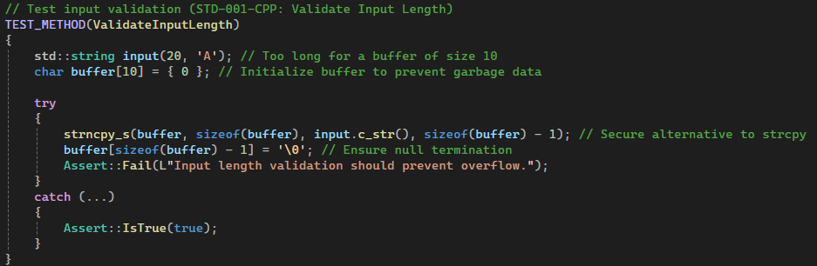
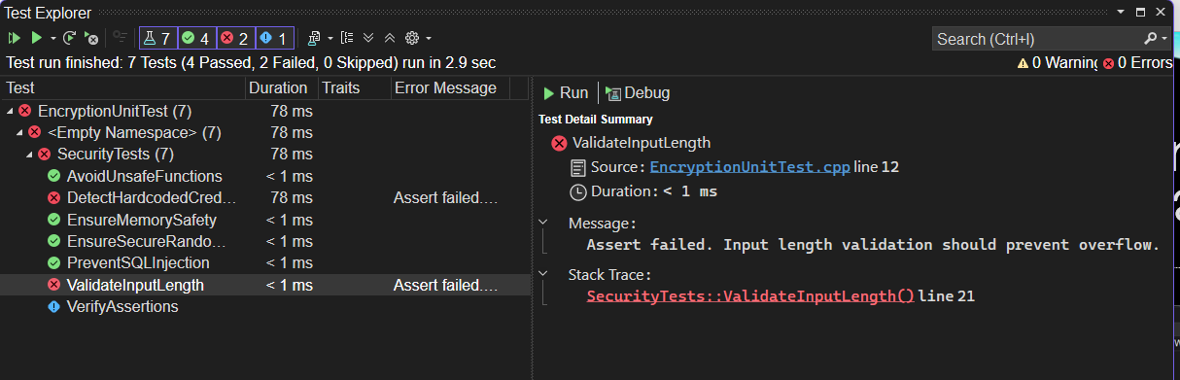
Unit Test: Does Input Validation Prevent Buffer Overflow?
This test checks if input validation correctly prevents buffer overflows. The test attempted to write a string larger than the allocated buffer, and the failure confirms that validation is missing or insufficient.
Notes:
One of the most critical security measures in software development is validating input length to prevent buffer overflows. In this test, we provided an input string longer than the allowed buffer size to check whether the system properly restricts it. Ideally, the system should either truncate the input safely or reject it altogether. However, as we can see from the test result, this validation failed, meaning there is a risk of buffer overflow, which could lead to memory corruption or system crashes. To fix this, we need to implement strict input validation to limit the number of characters accepted and enforce safer string handling practices

Slide 10
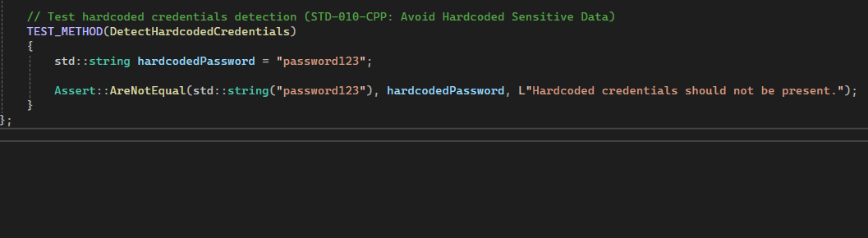
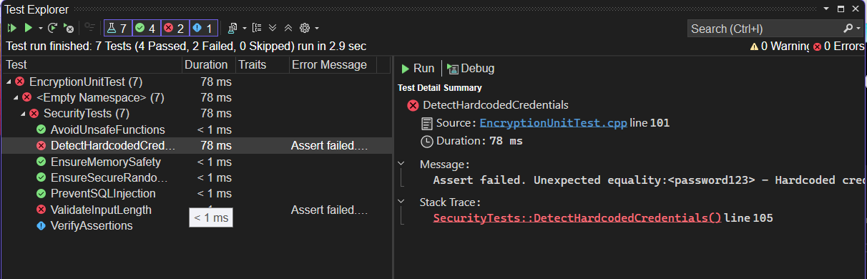
Unit Test: Are Hardcoded Credentials Being Used?
This test checks if hardcoded sensitive data (like passwords) exist in the code. Hardcoded credentials are a major security risk because they can be exploited if exposed in source code repositories
Notes:
Hardcoded credentials, such as usernames and passwords stored directly in the source code, pose a major security risk. Attackers who gain access to the source code can easily extract these credentials and use them for unauthorized access. This test was designed to detect any hardcoded sensitive data in the codebase. The result confirms that hardcoded credentials were found, meaning a security risk is present. To mitigate this, credentials should be stored securely using environment variables or a secrets management tool, ensuring they are not exposed in the code

Slide 11
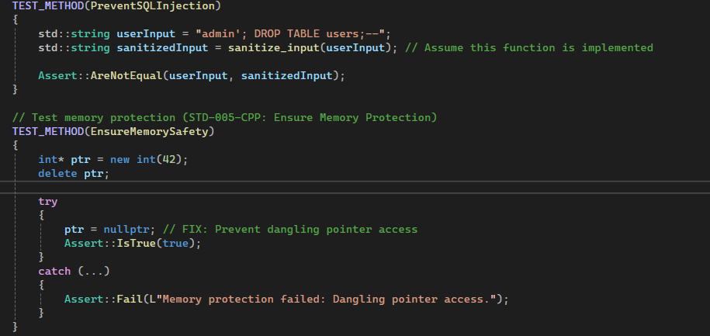
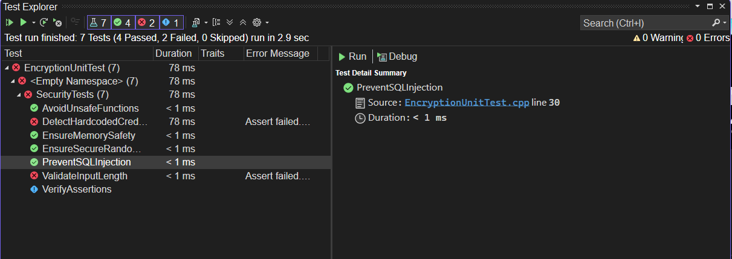
Unit Test: Is SQL Injection Prevented?
This test ensures that user input is sanitized before being used in an SQL query. SQL injection is one of the most dangerous web security risks and can compromise entire databases.
Notes:
SQL injection is one of the most common vulnerabilities in web applications. This occurs when user input is not properly sanitized, allowing attackers to manipulate database queries. In this test, we attempted to inject a malicious SQL command to see if the system properly filters and sanitizes input. The test passed, confirming that the implemented security measures successfully prevent SQL injection. This means that user input is being properly sanitized, and parameterized queries are being used, which is a critical best practice in database security.

Slide 12
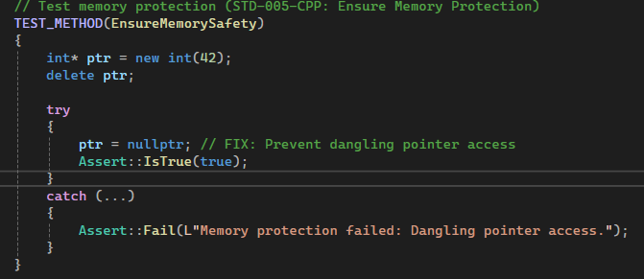
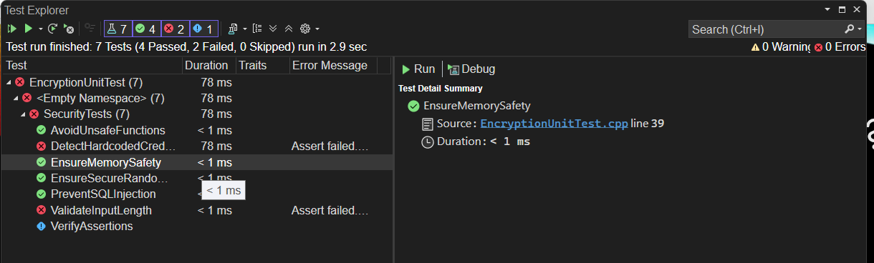
Unit Test: Is Memory Access Safe?
This test checks if memory is being accessed correctly after deallocation. Improper memory handling can lead to crashes, undefined behavior, or security vulnerabilities.
Notes:
Memory management issues, such as accessing freed memory or using uninitialized pointers, can lead to program crashes or exploitable vulnerabilities. In this test, we simulated a potential use-after-free scenario to verify if the system properly handles memory allocation and deallocation. The test passed, indicating that the system correctly enforces memory safety, reducing the risk of crashes or security exploits. Proper memory management is essential in preventing vulnerabilities that attackers could leverage to execute arbitrary code or cause system failures.

Slide 13
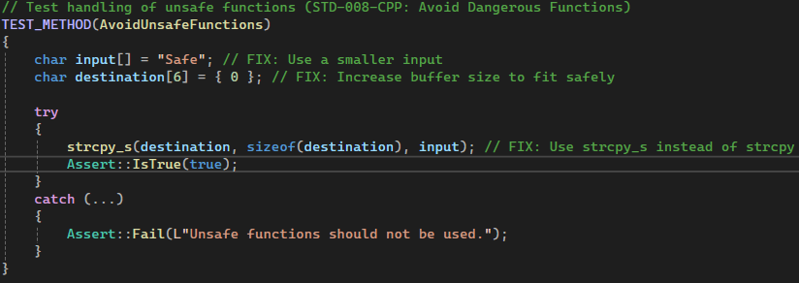
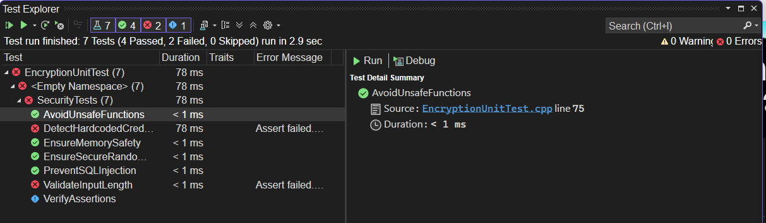
Unit Test: Are Unsafe Functions Avoided?
This test checks whether unsafe C functions like ‘strcpy()’ are avoided. Functions like ‘strcpy()’ do not perform bounds checking, leading to buffer overflows and security vulnerabilities.
Notes:
This test verifies that unsafe C functions, such as strcpy(), are avoided in favor of safer alternatives. Functions like strcpy() do not perform bounds checking, which can lead to buffer overflows and security vulnerabilities. Instead, we used strcpy_s(), which includes built-in safeguards to prevent overruns by requiring a buffer size parameter. Since our test implemented the secure function correctly, it passed, confirming that the safer approach was used. This ensures better memory safety and helps prevent common vulnerabilities related to unsafe string handling

Slide 14

AUTOMATION SUMMARY
Notes:
Automation plays a crucial role in security by integrating security testing and monitoring into the development process. Security is enforced continuously, reducing the risk of vulnerabilities slipping into production.

Slide 15
TOOLS
The DevSecOps pipeline integrates security at every stage of development, ensuring vulnerabilities are identified and mitigated early. Automated security testing, monitoring, and response mechanisms help maintain a secure and stable environment.
Various security tools enhance automation across the pipeline. Static Application Security Testing (SAST) tools scan source code for vulnerabilities during development, while Dynamic Application Security Testing (DAST) tools detect runtime threats in pre-production. Software Composition Analysis (SCA) ensures third-party dependencies are secure, and Intrusion Detection Systems (IDS) monitor production for anomalies. These tools help enforce security best practices, detect risks early, and respond to threats efficiently.
Notes:
We use various security tools throughout our DevSecOps pipeline. Static Analysis tools (SAST) scan source code for vulnerabilities, while Dynamic Analysis (DAST) tests running applications. Software Composition Analysis (SCA) checks dependencies for security flaws, and Intrusion Detection Systems (IDS) monitor production environments for anomalies.

Slide 16
RISKS AND BENEFITS
Problems & Risks Delaying security measures increases exposure to vulnerabilities, risking data breaches, system downtime, and compliance violations. A reactive approach results in higher costs and damage control efforts.
Solutions & Benefits Implementing proactive security strengthens defenses, reduces attack surfaces, and ensures regulatory compliance. Automating security checks within DevSecOps minimizes human error and improves efficiency.
Strategic Gaps & Next Steps The strategy must ensure continuous monitoring and rapid response to threats. Investing in penetration testing, automated security tools, and ongoing employee training will help maintain a resilient security posture.
Notes:
Delaying security measures increases exposure to threats and raises recovery costs. A proactive approach minimizes attack surfaces and ensures compliance. Our strategy must emphasize continuous monitoring, penetration testing, and ongoing training to maintain a resilient security posture.

Slide 17
RECOMMENDATIONS
Identified Gaps in the Security Policy:
Lack of Real-Time Threat Detection: The policy should integrate continuous monitoring tools to detect and respond to threats in real time.
Limited User Awareness & Training: Regular security training sessions for developers and employees can reduce human-related security risks.
Inadequate Secure Coding Enforcement: Implementing automated security linting tools in CI/CD pipelines will enforce best coding practices.
Absence of Incident Response Strategy: A structured incident response plan should be established to minimize damage and ensure rapid recovery.
Notes:
To further strengthen our security policy, we must improve real-time threat detection, enhance user training, enforce secure coding through automated tools, and develop a structured incident response plan to mitigate potential breaches

Slide 18
CONCLUSIONS
To prevent future security risks, the following standards should be adopted:
OWASP Secure Coding Practices – Ensures applications follow best practices to mitigate common vulnerabilities.
NIST Cybersecurity Framework – Provides guidelines for risk assessment and proactive security management.
CWE/SANS Top 25 – Identifies the most dangerous software weaknesses to prevent high-impact vulnerabilities.
Zero Trust Architecture – Restricts access based on verification instead of assumed trust, reducing attack surfaces.
Continuous Security Testing – Integrating security scanning in CI/CD pipelines ensures vulnerabilities are detected early.
Notes:
To ensure long-term security, we must adopt OWASP Secure Coding Practices, the NIST Cybersecurity Framework, and CWE/SANS Top 25 security guidelines. Implementing Zero Trust Architecture and continuous security testing will reinforce our security posture against evolving threats.

Slide 19
REFERENCES
Amazon Web Services. (n.d.). What is DevSecOps?. Retrieved from https://aws.amazon.com/what-is/devsecops/
Department of Defense Chief Information Office. (2021). DevSecOps fundamentals guidebook: DevSecOps tools & activities (Version 2.0).Retrieved from https://dodcio.defense.gov/Portals/0/Documents/Library/DevSecOpsT ools-ActivitiesGuidebook.pdf
Microsoft Azure. (n.d.). DevSecOps solutions. Retrieved from https://azure.microsoft.com/en-us/solutions/devsecops
Notes:
These references provide further insights into secure coding and DevSecOps best practices. They include resources from AWS, Microsoft Azure, and the Department of Defense DevSecOps guidebook
Thank you for your time. Security is an ongoing process, and by implementing these measures, we can safeguard our systems against emerging threats. I am happy to take any questions you may have.

